Slide 1

Module 1-Introduction to Big Data & Hadoop

Slide 2
Introduction to Big Data

Slide 3
Outline
Definition (not a standard one) of Big Data
Characteristics of Big Data (4/5 Vs)
Traditional verses Big Data Solutions
Application areas

Slide 4
Big Data Definition
Data sets that are too large and complex to manipulate or interrogate with standard methods or tools.
“Big Data” is data whose scale, diversity, and complexity require new architecture, techniques, algorithms, and analytics to manage and extract value and hidden knowledge from it.
Examples : Google, Yahoo, Facebook, eBay, Amazon …

Slide 5
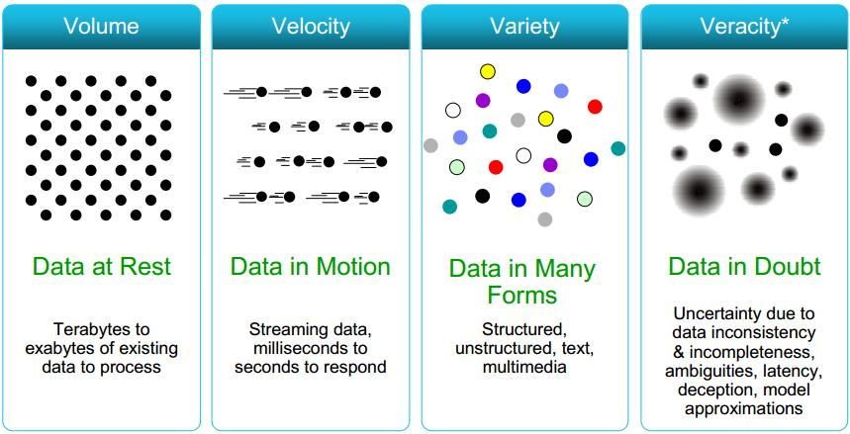
Big Data Characteristics (4Vs)

Slide 6
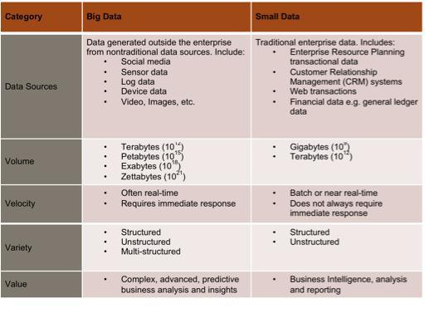

Slide 7
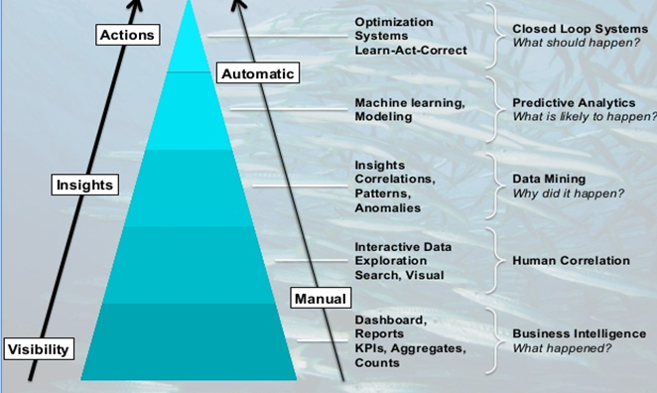
Why Big Data Mining???
Wisdom
Knowledge
Information
Data

Slide 8
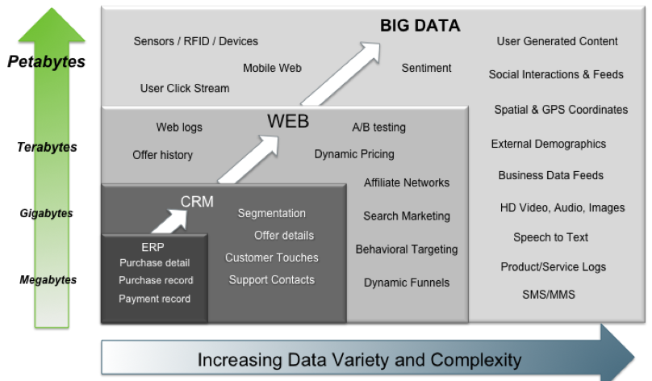
Notes:
Transactions are pretty simple to understand. This is our ERP data. It is the data that we maintain and track in our OLTP systems. It can be any record of any system-to-system or human-to-system interaction. It can even be a human-to-human interaction as long as it is captured electronically. We use a lot of this data in our analytics today.
Interactions are the points in time we relate with a system. It could be a tweet or a facebook post. It could be an electronic or paper customer satisfaction survey. Interactions are web logs and A/B tests. We have a lot of this data but typically no efficient way to understand or extract value from it.
Observations are interesting because they represent a world of net new data sources that we once never thought of analyzing. It is data that was once thought of as low to medium value data or even exhaust data that was too bulky and just too expensive to store. This can be machine-generated data from sensors or web logs and clickstreams or even audio/video or largely unstructured content. Typically, we never even thought of this data before.

Slide 9
Introduction to Hadoop

Slide 10
Core Components of HADOOP

Slide 11
Hadoop Core Component 1
HDFS
A file system designed to store large amounts of data across multiple nodes of commodity hardware.
HDFS has a master–slave architecture made up of data nodes which each store blocks of the data, retrieve data on demand, and report back to the name node with inventory.
The name node keeps records of this inventory (references to file locations and metadata) and directs traffic to the data nodes upon client requests.
This system has built-in fault tolerance, typically keeping three or more copies of each data block in case of disk failure.

Slide 12
High Level Hadoop Architecture

Slide 13
Hadoop Distributed File System

Slide 14
Hadoop Core Component 2
MapReduce Data processing engine:
A MapReduce job consists of two parts, a map phase, which takes raw data and organizes it into key/value pairs, and a reduce phase which processes data in parallel.
Hadoop MapReduce is a software framework for easily writing applications which process vast amounts of data in-parallel on large clusters ( thousands of nodes) of commodity hardware in a reliable, fault tolerant manner.

Slide 15
MapReduce (Hadoop’s computation engine)

Slide 16
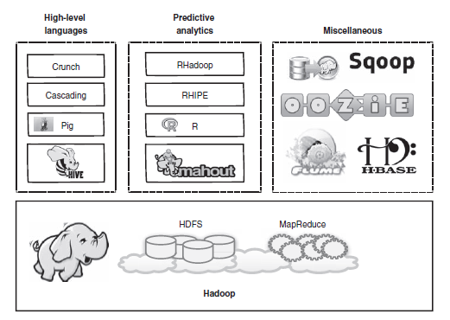
Core Components of Hadoop with other services

Slide 17
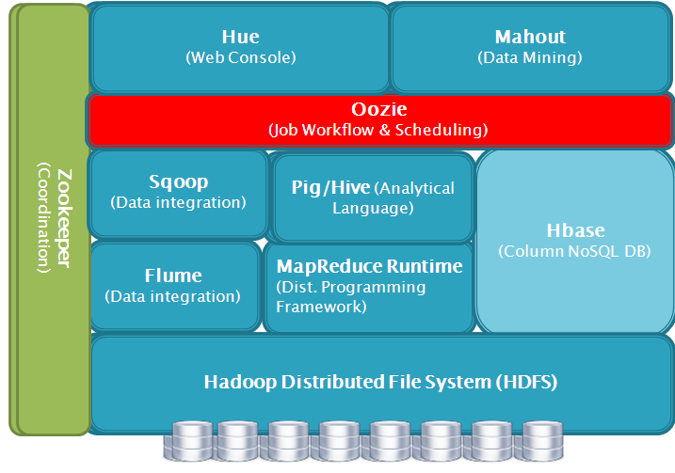
Hadoop Ecosystem
It is Apache’s open source software framework for storing, processing and analyzing big data.

Slide 18
Hadoop Ecosystem
Hive : It is SQL-like interface to Hadoop. It is an abstraction on top of MapReduce. allows users to query data in the Hadoop Cluster without knowing java or MapReduce. Uses HiveQL language very similar to SQL.
Pig : Pig is an alternative abstraction on top of MapReduce. It uses a dataflow scripting language called as PigLatin. The Pig interpreter runs on the client machine. Takes the PigLatin script and turns it into a series of MapReduce jobs and submits those jobs to the cluster.

Slide 19
Hadoop Ecosystem
HBase : HBase is "Hadoop Database" .It is 'NoSQL' data store. It can store massive amount of data e.g. Gigabyte, terabyte or even pet bytes of data in a table. MapReduce is not designed for iterative processes.
Flume : It is distributed real time data collection service. It efficiently collects, aggregate and move large amounts of data.
Sqoop : It provides a method to import data from tables in relational database into HDFS. It supports easy parallel database import/export. User can insert data from RDBMS to HDFS , Export data from HDFS to back into RDBMS.

Slide 20
Hadoop Ecosystem
Oozie - Oozie is workflow management project. Oozie allows developers to create a workflow of MapReduce jobs including dependencies between jobs. The Oozie server submits the jobs to the server in the correct sequence.
Hue : It is an open source web interface that supports Apache Hadoop and its ecosystem licensed under the Apache licence. Hue aggregates the most common Apache Hadoop components into a single interface and targets the user experience/UI Toolkit.

Slide 21
Hadoop Ecosystem
Mahout - It is machine learning tool. It supports distributed and scalable machine learning algorithms on the Hadoop Platform and helps in building intelligent applications easier and faster. It can provide distributed data mining function combined with Hadoop.
ZooKeeper : It is a centralized service for maintaining configuration information . It provides distributed synchronization. It contains a set of tools to build distributed applications that can safely handle partial failures. Zookeeper was designed to store coordination data, status information, configuration , location information about distributed application.

Slide 22
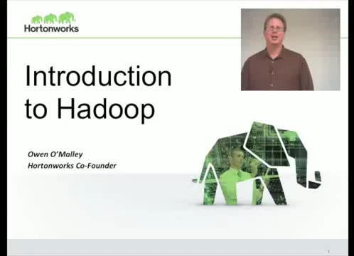

Slide 23
Quiz Time
https://forms.office.com/r/Qx2g003PR2
Link will be active on 30th July 2024 at 9:30 am. Duration for the quiz is 30 mins.

Slide 24
Thank You

